Slide 1
Accelerate and Compress Neural Network using Hash Algorithms
Zi Liang
2020.1.5

Slide 2
Contents
Why need to use: Differences from classical methods
Where to use: common combination routine
Example: Reformer

Slide 3
Classical compression Method
1. Parameter Pruning and Sharing
2. Low-rank Factorization
3. Transferred/compact Convolutional Filters
4. Knowledge Distillation
5. Neural Architecture Search(NAS)
6. Auto Model Compression(AMS)
…

Slide 4
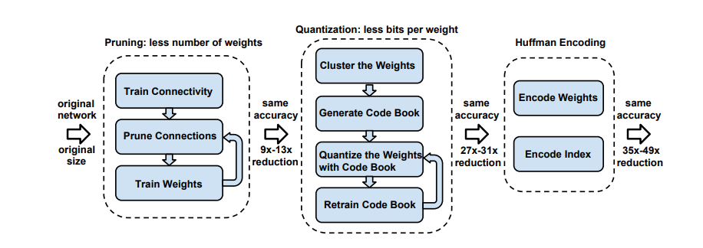
Pruning
All connections with weights below a threshold are removed from the network
CSS: Compressed Sparse Storage
Song Han, Deep Compression: Compressing Deep Neural Networks With Pruning, Trained Quantization and Huffman Coding, ICLR 2016 Best Paper

Slide 5
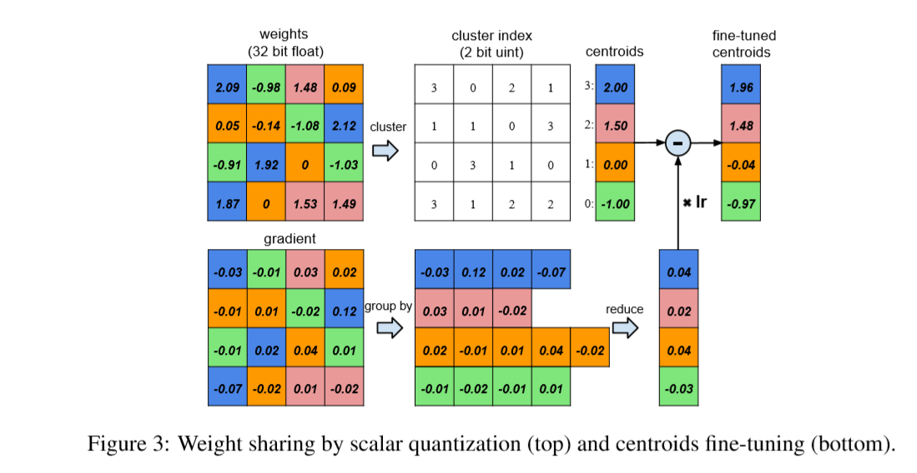
Quantization and parameter sharing
average
b-bit: using less bits per value
sum
Cluster: per-bins has each sharing parameter.
Song Han, Deep Compression: Compressing Deep Neural Networks With Pruning, Trained Quantization And Huffman Coding, ICLR 2016

Slide 6
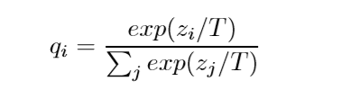
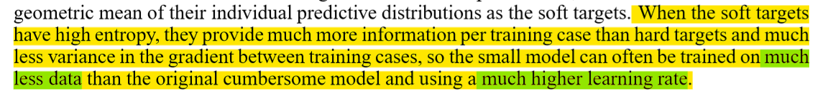
Knowledge Distillation
Transfer knowledge to a small model from a cumbersome model
Distillation strategy
If T is large, the distribution is soft; soft-targets
else: Hard-targets
Geoffrey Hinton, Distilling the Knowledge in a Neural Network, NIPS 2015

Slide 7
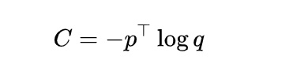
Knowledge Distillation
Unlabeled data
Original Model
p: softmaxVector of original model
Training with high T, testing with T=1
Small Model
q: softmaxVector of small model
Geoffrey Hinton, Distilling the Knowledge in a Neural Network, NIPS 2015

Slide 8
Knowledge Distillation
Unlabeled data
Original Model
p: softmaxVector of original model
Training with high T, testing with T=1
Small Model
q: softmaxVector of small model
Data in dataset
Small Model
Training and testing with T=1
label
C=C_unlabeled *T^2+C_labeled
Geoffrey Hinton, Distilling the Knowledge in a Neural Network, NIPS 2015

Slide 9
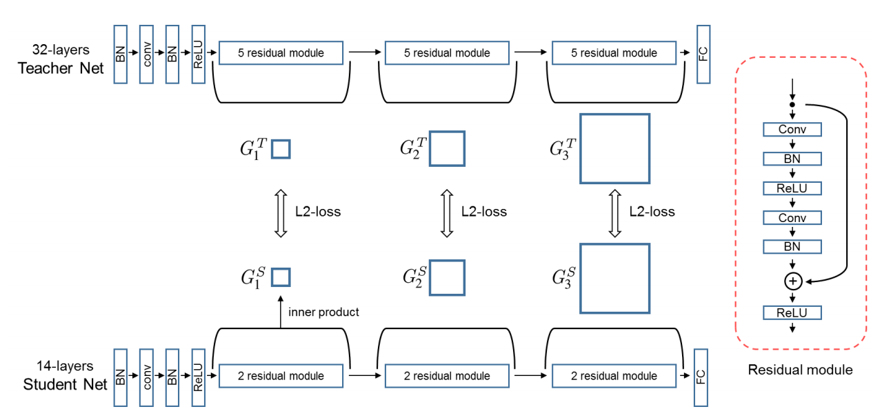
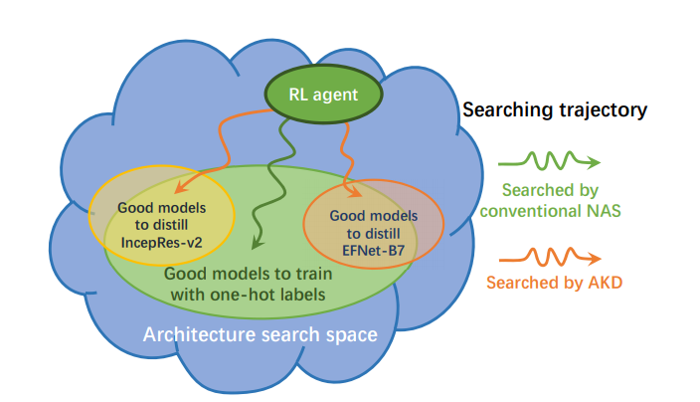
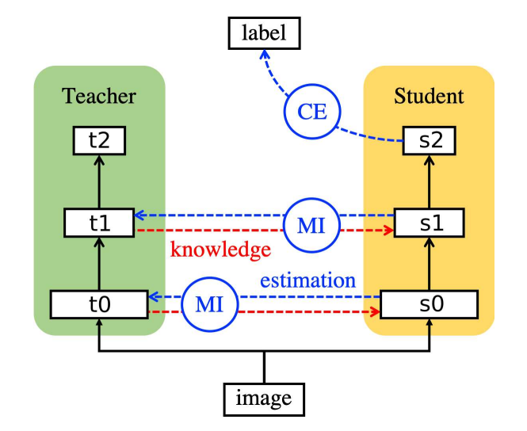
Other Methods
Distillation + attention
Distillation + NAS
Pruning + NAS
Junho Yim, A Gift from Knowledge Distillation: Fast Optimization, Network Minimization and Transfer Learning, CVPR 2017
Ji Wang, Private Model Compression via Knowledge Distillation, AAAI 2019
Sungsoo Ahn, Variational Information Distillation for Knowledge Transfer,CVPR 2019
Yu Liu, Search to Distill: Pearls are Everywhere but not the Eyes, ? ? ?

Slide 10
Characteristics of Classical Method
Parameter-level(like Pruning)
Pooling strategy(like sharing)
? ? ?(like distillation)
Optimization: RL & EA (like something + NAS)
So Where to use data mining algorithms for this task?

Slide 11
Reformer
1. Computation efficient → memory efficient
2. Parameter sharing
3. Decreasing the complexity using hash.
Nikita Kitaev, , Reformer: the Efficient Transformer, ICLR 2020.

Slide 12
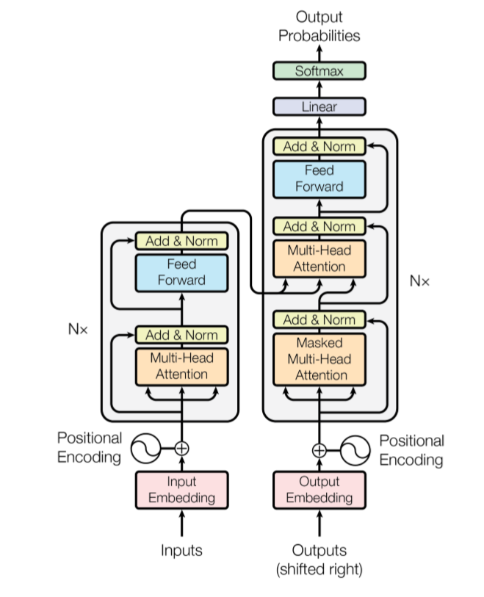
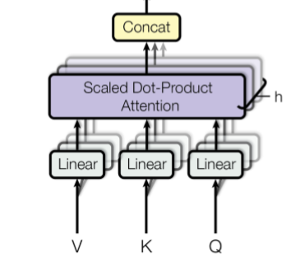

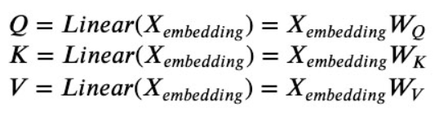

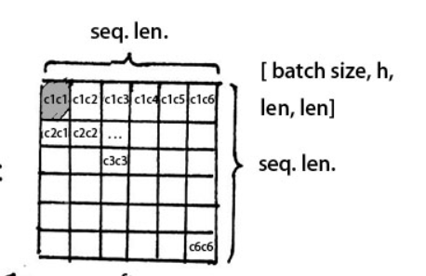
1. Parameter Sharing
Nikita Kitaev, , Reformer: the Efficient Transformer, ICLR 2020.

Slide 13
1. Parameter Sharing
Q=K
Nikita Kitaev, , Reformer: the Efficient Transformer, ICLR 2020.

Slide 14
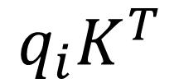

2. Decreasing the complexity in higher level
$$q_{i}K^{T}$$
Shape(Q)=[batchsize, lengthofSequence, dimensionofEmbadding/NumOfHead]
Shape(QK^T)=[batchsize, lengthofSequence, lengthofSequence]
Since softmax is dominated by the largest elements, for each query q we only need to focus on the keys in K that are closest to q.
For example, if K is of length 64K, for each q we could only consider a small subset of, say, the 32 or 64 closest keys.
Maximum Inner Product Search
$$\underset{j=1,2,…,n, j≥i }{arg max}{q_{i}K_{j}^{T}}$$
Locality Sensitive Hashing
Nikita Kitaev, , Reformer: the Efficient Transformer, ICLR 2020.

Slide 15
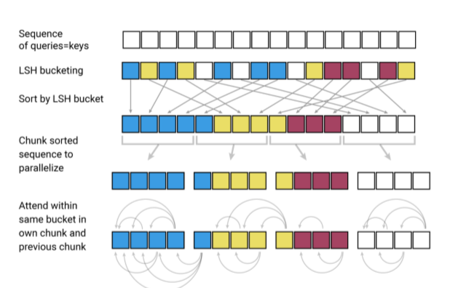
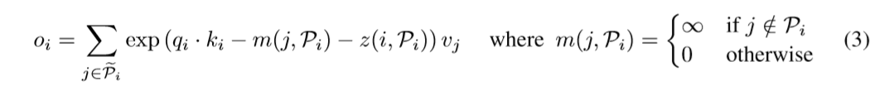
2. Decreasing the complexity in higher level
q1
Q or K
Nikita Kitaev, , Reformer: the Efficient Transformer, ICLR 2020.

Slide 16
2. Decreasing the complexity in higher level
q1
Q or K
Select the largest elements
Scaled or Nomalization, like sqrt(d_k) in softmax
Nikita Kitaev, , Reformer: the Efficient Transformer, ICLR 2020.

Slide 17
3. Summery of procedure in reformer
Combination (LSH + transformer)
Method of combination (Maximum Inner Product Search in Self-attention)
Approximation (Q=K? softmax)
Experiment (if Q=K,… or the solution of compression)
Find a scene (long sequence series)
Nikita Kitaev, Reformer: the Efficient Transformer, ICLR 2020.

Slide 18

Test this procedure
LSH + GCN
A is the adjacency matrix
T. N. Kipf, Semi-supervised classiﬁcation with graph convolutional networks, ICLR 2017

Slide 19
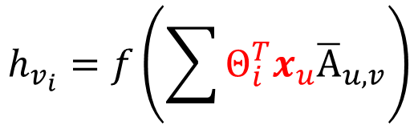
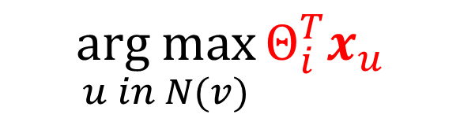
Test this procedure
LSH + GCN
A is the adjacency matrix
$$h_{v_{i}}=f\left(\sum{Θ_{i}^{T}x_{u}{\overline{A}}_{u,v}}\right)$$
d*1
Maybe we only need some of the largest elements
$$\underset{u in N(v)}{arg max}{Θ_{i}^{T}x_{u}}$$
Efficient in large scale graph and dense connection
T. N. Kipf, Semi-supervised classiﬁcation with graph convolutional networks, ICLR 2017

Slide 20
Thanks

